Slide 1
Introduction to JAVA Programming CSIT751 (PG) (CORE JAVA MODULE I)

Slide 2
Topics Covered:
Java Introduction
JDK, JRE and JVM
Features of Java
Java program structure
Identifiers, keywords and variables
Data Types
Control structures and loops
Arrays
Command line arguments

Slide 3
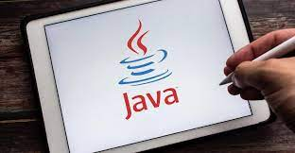
Introduction to Java
Object oriented programming language.
Although Java is not pure object-oriented programming but almost everything is object in Java except its primitive datatypes
It supports all object-oriented programming features:
Class and Object
Encapsulation
Abstraction
Inheritance
Polymorphism etc.

Slide 4
History of Java
Click here to get latest file
Version | Date
JDK Beta | 1995
JDK 1.0 | January 23, 1996
JDK 1.1 | February 19, 1997
J2SE 1.2 | December 8, 1998
J2SE 1.3 | May 8, 2000
J2SE 1.4 | February 6, 2002
J2SE 5.0 | September 30, 2004
Java SE 6 | December 11, 2006
Java SE 7 | July 28, 2011
Java SE 8 (LTS) | March 18, 2014
Java SE 9 | September 21, 2017
Java SE 10 | March 20, 2018
Java SE 11 (LTS) | September 25, 2018
Java SE 12 | March 19, 2019
Java SE 13 | September 17, 2019
Java SE 14 | March 17, 2020
Java SE 15 | September 15, 2020
Java SE 16 | March 16, 2021
Java SE 17 (LTS) | September 14, 2021
Java SE 18 | March 22, 2022
Java SE 19 | September 20, 2022
Java SE 20 | March 21, 2023
Java SE 21 (LTS) | September 19, 2023

Slide 5
JDK, JRE and JVM
JDK: Java Development Kit is a software development environment
- used for developing Java applications and applets.
JRE: JRE stands for Java Runtime Environment
- It provides an environment to run only the Java program onto the system.
JVM: JVM stands for Java Virtual Machine
- It is responsible for executing the Java program.

Slide 6
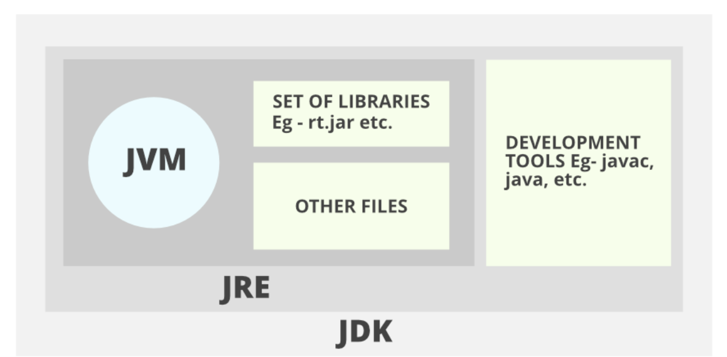
JDK, JRE and JVM

Slide 7
JDK is Java Development Kit. The Java Development Kit (JDK) is a software development environment which is used to develop Java applications.
JRE (Java Runtime Environment) is an installation package that provides an environment to only run(not develop) the java program (or application) onto your machine. JRE is only used by those who only want to run Java programs.

Slide 8
JVM (Java Virtual Machine) is a very important part of both JDK and JRE because it is contained or inbuilt in both. Whatever Java program you run using JRE or JDK goes into JVM and JVM is responsible for executing the java program line by line, hence it is also known as an interpreter.

Slide 9
Features of Java Language
Easy to develop applications
Platform Independent
Portable
Multithreaded
Distributed
Object Oriented
Community Support
Scalability

Slide 10
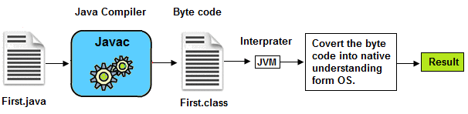
1. Easy to develop applications
As compared to C and C++ , no pointer concept
Atomatic memory allocation and deallocation which makes easy to develop applications.

Slide 11
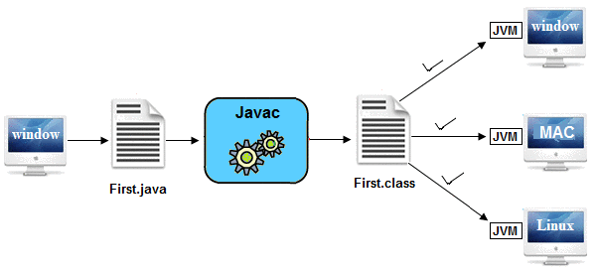
2. Platform Independent
Java's platform independence is a key feature is achieved through the concept of "Write Once, Run Anywhere" (WORA).
Java source code is compiled into an intermediate form known as bytecode.
Once compiled to bytecode, Java programs can be executed on any device that has a JVM installed.
Developers can write code on one platform (e.g., Windows) and run it on another platform (e.g., Linux) without modification.
Java programs are executed by the Java Virtual Machine (JVM).
JVM is platform-specific, but the bytecode is interpreted by the JVM, making the program platform-independent.

Slide 12
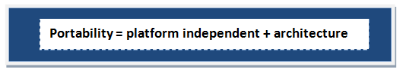
3. Portable
Java programs can be easily moved from one computer system to another, providing portability and flexibility.
Platform independent and architectural neutral features makes its portable.

Slide 13


4. Multithreaded
You can perform multiple operations at the same time.
Threads are independent, so it doesn't affect other threads.
Typing MS Word document while listening to music.

Slide 14
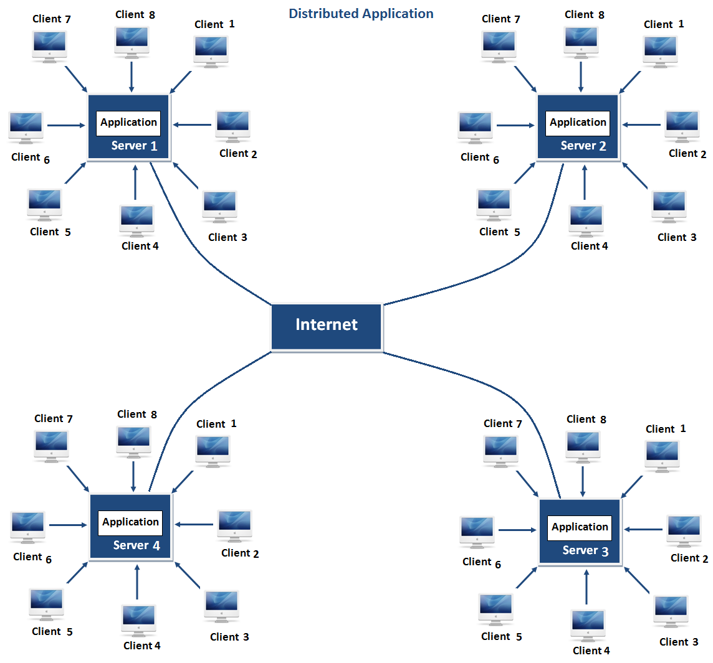
5. Distributed
Java includes features for distributed computing, making it suitable for building networked applications.
Same application can run in different different server.
Advantage: problem occurred in one server will never be reflected on any client system.

Slide 15
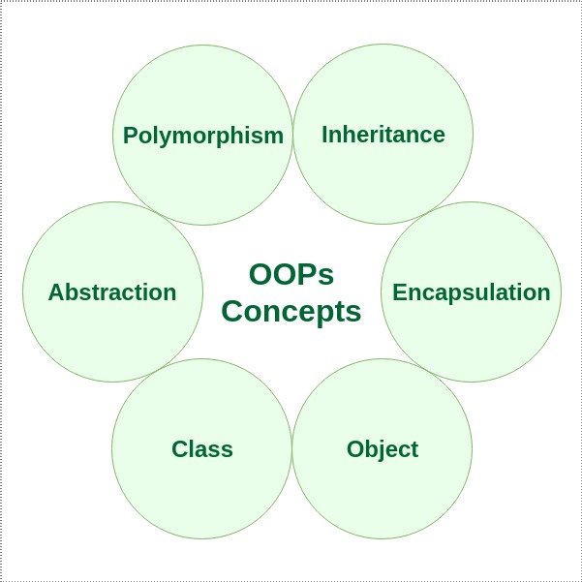
6. Object Oriented
Java is object-oriented, promoting the use of classes and objects in programming. Everything in Java is treated as an object.

Slide 16
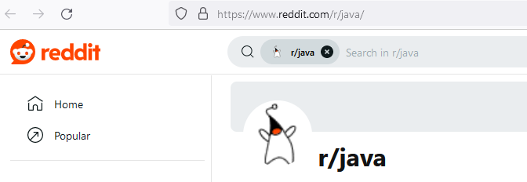
7. Community Support
Java has a large and active community of developers, providing extensive resources, libraries, and frameworks.
Numerous online forums and communities provide platforms for Java developers to seek help, share their expertise, and discuss various topics related to Java programming. Examples include Stack Overflow, Reddit (r/java), and the Oracle Community forums.

Slide 17

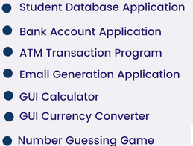
8. Scalability
Java applications can scale easily, making them suitable for both small-scale and large-scale projects.

Slide 18
Java program structure
Basic structure of Java Program:
[ Documentation ]
[package declarations]
[import statements]
[class declaration]
[Main Method]

Slide 19
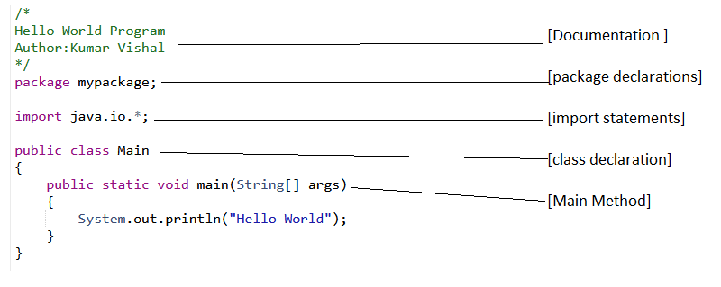
Basic structure of Java Program:

Slide 20
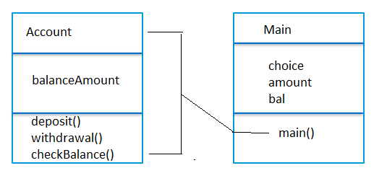
Writing simple Java class and main() method
Simple Java Class
Java Main Method

Slide 21
Identifiers
A name which is used for identifying any entity.
Identifier can be a class name, object name, method name, variable name, property name etc..
Identifier name should be meaningful not meaningless and always it follow naming convention rule.
Now a days industry are following camel case/ Pascal Case style to define identifier name.

Slide 22
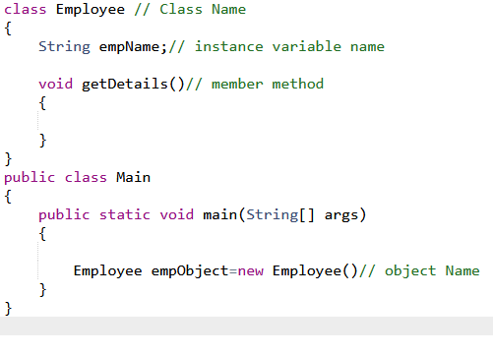
Identifiers Example

Slide 23
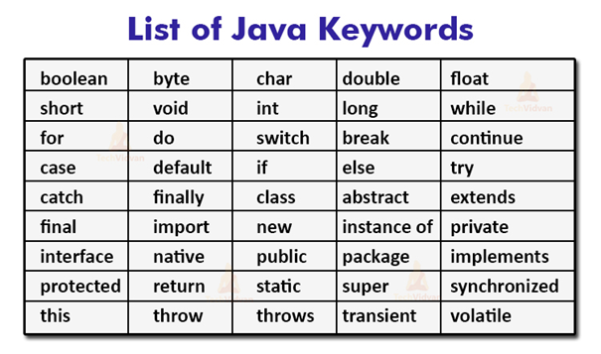
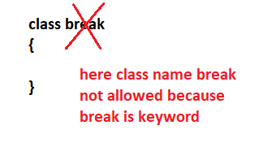
keywords
Reserve words in java is called java keywords. As we know keywords are not allow to use for any identifiers name.

Slide 24
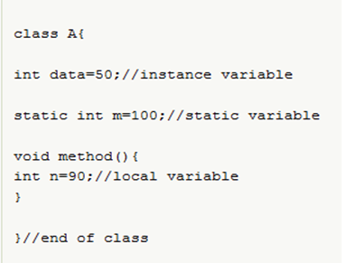
variables
A name of storage location is called variable. Variable can be defined their own scope. So, we can categorize the variable with the help of its type and its scope.
According to types:
syntax:
varibaleType variableName;
eg: int registrationNumber;
According to scope:
it can be local, instance and static

Slide 25
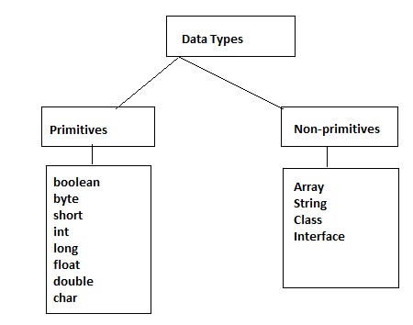
Primitive Data Types
Data types in Java: Data types means type of your data or user input. To define our data which will be use in our application we need to define with its type so, that our compiler can understand what operation or task we want to perform.
In java we can categorize data types in two ways : one is primitive and another one is non primitive

Slide 26
Primitive Data Types
Numeric Types:
Integral Types:
byte: 8-bit signed integer
short: 16-bit signed integer
int: 32-bit signed integer
long: 64-bit signed integer
Floating-Point Types:
float: 32-bit floating-point number
double: 64-bit floating-point number
Character Type:
char: 16-bit Unicode character
Boolean Type:
boolean: Represents true or false values
byte myByte = 127;
short myShort = 32000;
int myInt = 2000000000;
long myLong = 9223372036854775807L;
float myFloat = 3.14f;
double myDouble = 2.71828;
char myChar = 'A';

Slide 27
Non-Primitive Data Types
Reference Data Types:
Object Types:
String: Represents a sequence of characters.
Arrays: Collection of elements of the same type.
Custom Objects: User-defined classes and interfaces.
// String is a reference data type
String name = "Kumar";
// Arrays are reference data types
int[] numbers = new int[] { 1, 2, 3, 4 };
// Custom classes are reference data types
class Person {
String name;
int age;
}
Person personObj = new Person();

Slide 28
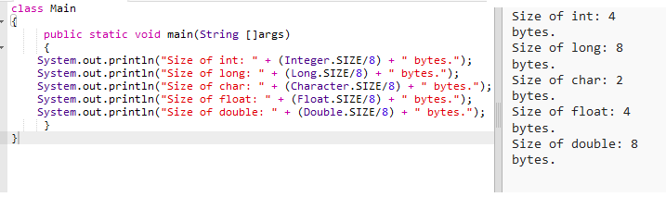
Program to get Size of Data Types
Click here to get Code

Slide 29

Introduction to Java Operators
Operators in Java are special symbols or keywords that are used to perform operations on operands. Operands can be variables, literals, or expressions. Here are some common types of operators in Java:
Arithmetic operators
Assignment operator
Relational operators
Logical operators
Bitwise operators
Unary operators
Ternary operators

Slide 30

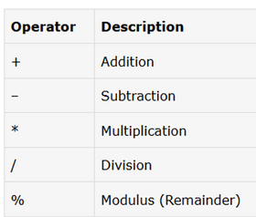
Arithmetic Operators
Scenario-Based Examples
Calculating the total cost of items in a shopping cart
Computing the average of exam scores

Slide 31
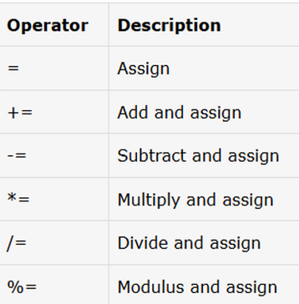
Assignment Operators
Scenario-Based Examples
Accumulating points in a game with +=
Adjusting inventory levels with -= and +=

Slide 32

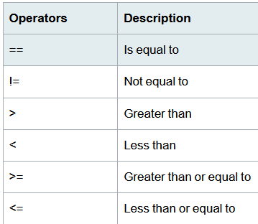
Relational Operators
Scenario-Based Examples
Checking if a user-provided password matches the stored password
Determining eligibility based on age for various services

Slide 33

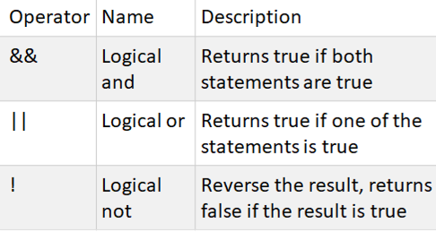
Logical Operators
Scenario-Based Examples
Implementing access control with logical AND
Validating multiple conditions using logical OR

Slide 34

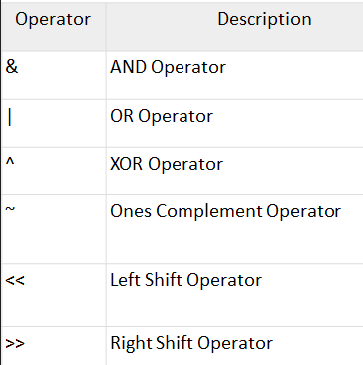
Bitwise Operators
Scenario-Based Examples
Let's consider a scenario where you have a set of user roles, and you want to use bitwise operations to manage and check these roles.

Slide 35

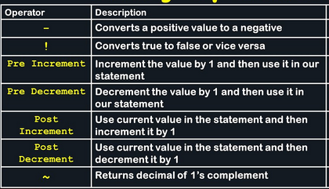
Unary Operators
Scenario-Based Examples:
A model for the progress of a task

Slide 36
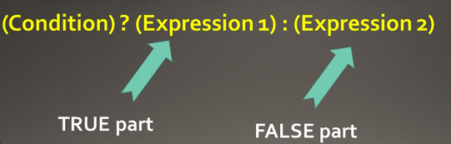
Ternary Operators
Scenario-Based Example:
Grading System

Slide 37
Operator precedence
Operator precedence in Java refers to the order in which operators are evaluated when an expression contains multiple operators. Operators with higher precedence are evaluated first. If two operators have the same precedence, their associativity determines the order of evaluation (left-to-right or right-to-left).
Precedence | Operators | Associativity
1 | () | Left-to-right
2 | ++, -- (postfix) | Left-to-right
 | +, - (unary) | Right-to-left
 | ~, ! | Right-to-left
3 | ++, -- (prefix) | Right-to-left
 | +, - (binary) | Left-to-right
4 | *, /, % | Left-to-right
5 | +, - (binary) | Left-to-right
6 | <<, >>, >>> | Left-to-right
7 | <, <=, >, >=, instanceof | Left-to-right
8 | ==, != | Left-to-right
9 | & | Left-to-right
10 | ^ | Left-to-right
11 | ` | `
12 | && | Left-to-right
13 | `
14 | ? : | Right-to-left
15 | =, +=, -=, *=, /=, %= | Right-to-left

Slide 38
Introduction to Control Statements
Definition of control statements:
Importance of control statements in programming
Overview of if/else and switch-case constructs

Slide 39
Control statements:
Control or conditional statements, also known as decision-making statements, are fundamental constructs in programming that allow the execution of certain code blocks based on specified conditions.

Slide 40

Importance of conTrol statements in programming
Decision-making: enable programs to make decisions based on specific conditions.
Control flow: determine the flow of execution within a program.
Flexibility: allow programs to react dynamically to different inputs or scenarios.
User interaction: enable programs to interact with users and respond to user input or events.

Slide 41
The if Statement
The if statement is a fundamental control flow statement in Java used for decision-making
It allows a program to execute a certain block of code only if a specified condition is true

Slide 42

if (condition)
{
// code block to be executed if the condition is true
}
Syntax

Slide 43
Example
int number = 10;
if (number > 0) {
System.out.println("The number is positive.");
}

Slide 44
The if-else Statement
The if-else statement extends the functionality of the if statement by providing an alternative block of code to execute when the condition is false
It allows a program to choose between two different courses of action based on the result of a condition

Slide 45
if (condition) {
// code block to be executed if the condition is true
} else {
// code block to be executed if the condition is false
}
Syntax

Slide 46
Example
int number = 7;
if (number % 2 == 0) {
System.out.println("The number is even.");
} else {
System.out.println("The number is odd.");
}

Slide 47
Nested if-else Statement
Nested if-else statements are if-else statements that are nested within other if-else statements
They allow for more complex decision-making by evaluating multiple conditions in a hierarchical manner

Slide 48
if (condition1) {
// code block to be executed if condition1 is true
if (condition2) {
// code block to be executed if both condition1 and condition2 are true
} else {
// code block to be executed if condition1 is true but condition2 is false
}
} else {
// code block to be executed if condition1 is false
}
Syntax

Slide 49

Example
Click Here
Consider a scenario where you want to determine the eligibility of a candidate for a job based on their qualifications and years of experience

Slide 50
Multiple if-else Statement
Multiple if-else statements are a series of if-else statements that are executed sequentially
They allow for handling multiple conditions independently, with each condition being evaluated in order

Slide 51
if (condition1) {
// code block to be executed if condition1 is true
}
if (condition2) {
// code block to be executed if condition2 is true
}
// Additional if-else statements as needed
else {
// code block to be executed if none of the conditions are true
}
Syntax

Slide 52
Example
int score = 85;
if (score >= 90) {
System.out.println("Grade: A");
}
if (score >= 80 && score < 90) {
System.out.println("Grade: B");
}
if (score >= 70 && score < 80) {
System.out.println("Grade: C");
}
if (score < 70) {
System.out.println("Grade: D");
}

Slide 53
The if-else-if Ladder
The if-else-if ladder is a series of if-else statements chained together, allowing for multiple conditions to be evaluated sequentially
It provides a more structured approach to decision-making compared to multiple if-else statements

Slide 54
if (condition1) {
// code block to be executed if condition1 is true
} else if (condition2) {
// code block to be executed if condition2 is true and condition1 is false
} else if (condition3) {
// code block to be executed if condition3 is true and conditions 1 and 2 are false
}
// Additional else-if statements as needed
else {
// code block to be executed if none of the conditions are true
}
Syntax

Slide 55
Example
int month = 9;
if (month == 1) {
System.out.println("January");
} else if (month == 2) {
System.out.println("February");
} else if (month == 3) {
System.out.println("March");
}
// Additional else-if statements for the remaining months
else {
System.out.println("Invalid month");
}

Slide 56
switch-case Statements
Switch-case statement
A switch-case statement is a control flow construct in programming that allows the program to evaluate a variable or expression against a list of possible values and execute specific code blocks based on the matched value.

Slide 57
switch (expression) {
case value1:
// code block to execute if expression matches value1
break;
case value2:
// code block to execute if expression matches value2
break;
// additional case labels as needed
default:
// code block to execute if expression does not match any case
}
Syntax

Slide 58
Example
Click Here
Consider a scenario where you want to determine week days

Slide 59
Enhanced switch-case feature introduced in Java 12.
Enhanced switch-case simplifies the syntax and allows for more expressive code.
switch (expression) {
case value1 -> expression1;
case value2 -> expression2;
// ...
default -> defaultExpression;
}
Syntax

Slide 60
Example
int dayOfWeek = 2;
String dayName = switch (dayOfWeek) {
case 1 -> "Monday";
case 2 -> "Tuesday";
case 3 -> "Wednesday";
case 4 -> "Thursday";
case 5 -> "Friday";
case 6, 7 -> "Weekend";
default -> "Invalid day";
};

Slide 61
Looping Controls in Java
While loop
Do while loop
For loop
Enhanced or advanced for loop
Nested loops means one loop inside another loop.

Slide 62
while loop:
A while loop is a control flow statement that allows code to be executed repeatedly based on a given Boolean condition. The while loop can be thought of as a repeating if statement.
Syntax :
while (boolean condition)
{
loop statements...
}

Slide 63
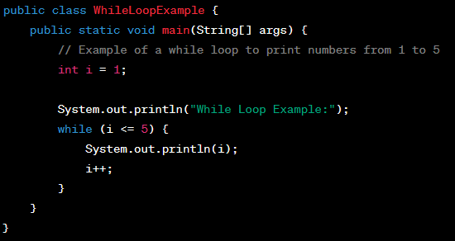
While Loop Example

Slide 64
for loop:
for loop provides a concise way of writing the loop structure. Unlike a while loop, a for statement consumes the initialization, condition and increment/decrement in one line thereby providing a shorter, easy to debug structure of looping.
Syntax:
for (initialization condition; testing condition;increment/decrement)
{
statement(s)
}

Slide 65
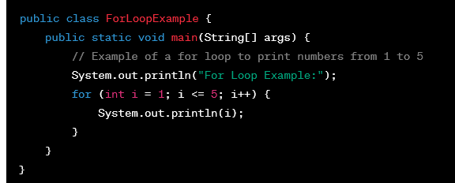
For Loop Example

Slide 66
do while:
do while loop is similar to while loop with only difference that it checks for condition after executing the statements, and therefore is an example of Exit Control Loop.
Syntax:
do
{
statements..
}
while (condition);

Slide 67
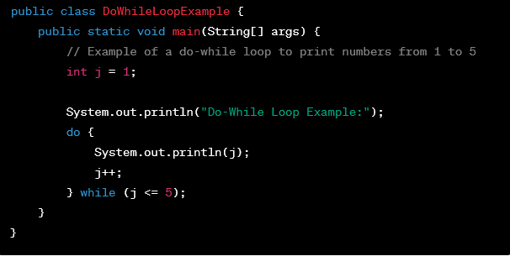
Do while Loop Example

Slide 68
Enhanced For loop
for(data_type variable : array | collection)
{
//body of for-each loop
}

Slide 69
Enhanced For loop Example:
int myArray[]=new int[]{11,12,13,14,15};
for(int num : myArray)
{
System.out.println(num);
}

Slide 70
Example: Sum of array elements
class Main {
public static void main(String[] args) {
// an array of numbers
int[] numbers = {3, 4, 5, -5, 0, 12};
int sum = 0;
// iterating through each element of the array
for (int number: numbers) {
sum += number;
}
System.out.println("Sum = " + sum);
}
}

Slide 71
Nested loops
A Nested loop means a loop statement inside another loop statement. That is why nested loops are also called “loop inside loop“.
Nested For loop
for ( initialization; condition; increment ) {
for ( initialization; condition; increment ) {
// statement of inside loop
}
// statement of outer loop
}

Slide 72
Java Arrays
Array is a collection of similar type of elements (Homogeneous)
Array have contiguous memory location.
In java, array is an object the contains elements of similar data type.
We can store only fixed elements in an array (Fixed Size).
Array is index-based, first element of the array is stored at 0 index.

Slide 73
Advantage of Array
Code Optimization: It makes the code-optimized, we can retrieve or sort the data easily.
Random access: We can get any data located at any index position.
Disadvantage of Array
Size Limit: We can store only fixed size of elements in the array.
It doesn't grow its size at runtime.
To solve this problem; collection framework is used in java.

Slide 74
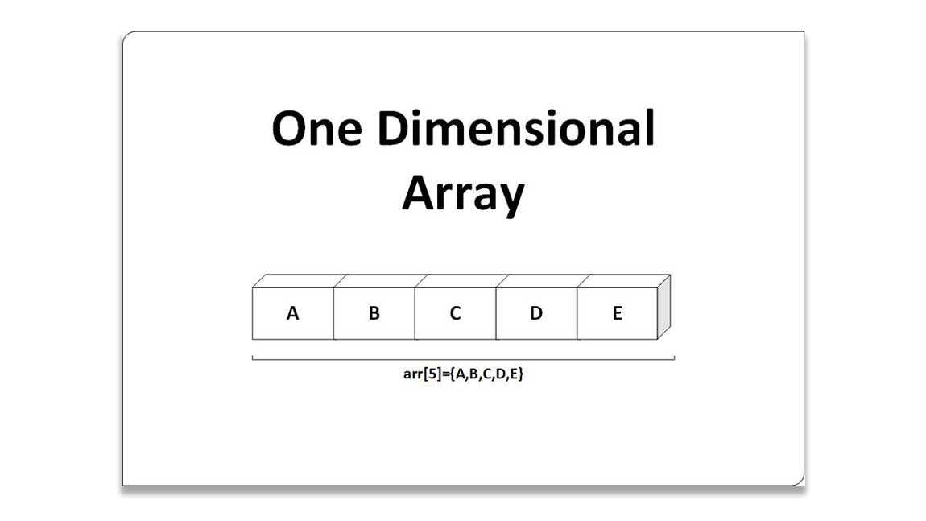
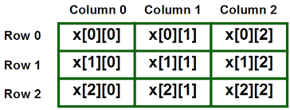
Types of Array: There are two types of array
Single Dimensional Array
1D array
Multidimensional Array
2D array
3D array etc.

Slide 75
Single Dimensional Array
The syntax for declaring and instantiating an array:
There are two ways to declare an array:
type[] arrayName;
type arrayName[];

Slide 76
How to instantiate an array
arrayName = new type[length];
How to declare and instantiate an array in one statement
type[] arrayName = new type[length];

Slide 77
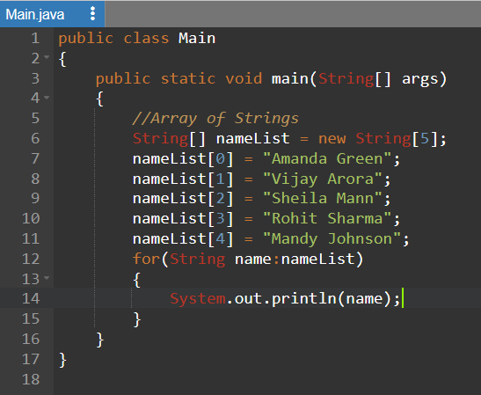
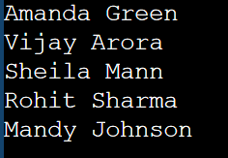

Slide 78
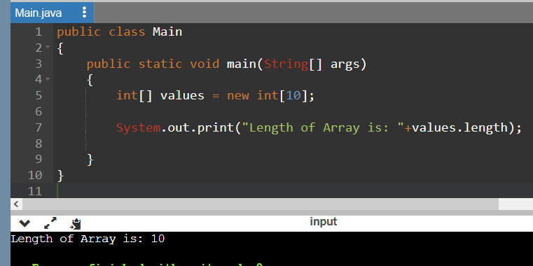
Array length
The syntax for getting the length of an array
arrayName.length

Slide 79
Two-dimensional arrays
The syntax for creating a rectangular array-
type[][] arrayName = new type[rowCount][columnCount];
A statement that creates a 3x2 array
int[][] numbers = new int[3][2];
3x2 array and initializes it in one statement
int[][] numbers =new int[][] { { 1, 2 }, { 3, 4 }, { 5, 6 } };

Slide 80
Enhanced for loop for 2D array
for (int[] num: arr)
{
for(int data: num)
{
System.out.println(data);
}
}

Slide 81
Command Line Arguments
The java command-line argument is an argument i.e. passed at the time of running the java program.
The arguments passed from the console can be received in the java program and it can be used as an input.
You can pass N(1,2,3 and so on) numbers of arguments from the command prompt.

Slide 82
Example CLA
Prog to get sum of arguments passed from the CLA
Class CLine1
{
public static void main (String args[])
{
int a = Integer.parseInt(args[0]);
int b = Integer.parseInt(args[1]);
int c = a + b;
System .out. println(“ sum of the ”+ a + “ and ” + b+ “ is :”+ c);
}
}

Slide 83
How to run
Compile this prog as
javac CLine1.java
Run this prog as
java CLine1 20 40
Output : 60

Slide 84
Example CLA
Prog to print all arguments passed from the CLA
Class CLine2
{
public static void main (String args[])
{
for(int i=0; i<args.length; i++)
{
System.out.println(args[i]);
}
}
}

